Slide 1
IT Postgraduate Project Orientation
Ernest Foo
Andrew Demasson
Ross Brown

Slide 2
Project Units
Unit Code | Unit Name | Credit Points
IFN701 | Project 1 | 24
IFN702 | Project 2 | 24
IFN665 | Advanced Topic 1 | 12
* Contribute towards IT43, IT44, IT53, IN20, IN21, IN22, IN23

Slide 3
How do Project Units Work
Project units are flexible
Projects are advanced units – must have completed 48 credit points
Students find topics and supervisors
You can complete a project on any topic:
Must be approved by a supervisor
Should be associated with your major
Must have enough workload for 24 credit points

Slide 4
Project Assessment

Slide 5
Assessment
Assessment Item | Weighting | Due Date
Project Plan | 15% | Week 4, 20th March
Oral Presentation | 25% | Week 14 2nd, 3rd, or 4th June
Written Report | 60% | 23rd June

Slide 6
Project Plan
A written submission through Blackboard grade centre
Criteria
Aims and Background
Significance
Approach and Methodology
Risk Assessment
Effective Written Communication
Due Week 4

Slide 7
Presentation
Publically advertised Oral Presentation
Email unit coordinator a presentation abstract for advertising at the beginning of week 13
Criteria
Knowledge and Understanding
Critical Analysis
Project Effort and Technical Skills
Effective Oral Communication
Due Week 14
Sessions will be organized by Major

Slide 8
Final Report
Major written report on all aspects of project
Submitted to Supervisor and Moderator – usually by email
Criteria
Understanding and Knowledge of Topic
Literature Review and Evidence of Reading
Project Approach
Analysis and Critical Reasoning
Effective Written Communication
Due end of exams

Slide 9
Criteria
There are common assessment criteria for all projects
However because all projects are different supervisors, moderators and students can agree together to alter them
Any alteration of assessment criteria must be defined in the Project Plan in week 4.
No assessment items can be cancelled so you must do a presentation and plan

Slide 10
Finding a Project

Slide 11
Finding A Project
It is up to the student to find a project topic
InPlace web application is used to record and advertise projects
http://inplace.qut.edu.au
Students can also suggest topics but must find a willing supervisor to guide the project

Slide 12


InPlace Opportunities
Notes:
This presentation will outline the student view of InPlace – specifically Applications.

Slide 13
What is InPlace?
InPlace is a university wide online system.
Used to manage WIL activities – projects, internships and placements.
Notes:
You can alter this slide to add any information regarding what role InPlace will play within your unit.

Slide 14
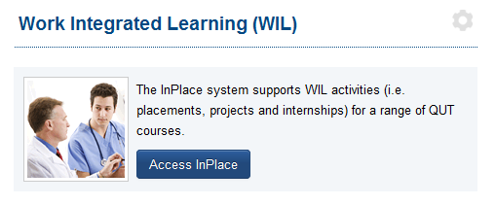
Where to Find InPlace
Students can find InPlace on
Black Board Unit Site -> Learning Resources
From the InPlace landing page:
Click on the Staff and Students link and login with your QUT username and password.
Follow this link:

Slide 15
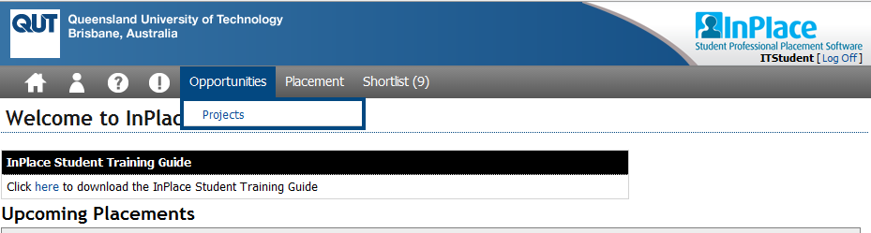
Navigating in InPlace
Go to the list of projects
Notes:
This is in their InPlace home screen.

Slide 16
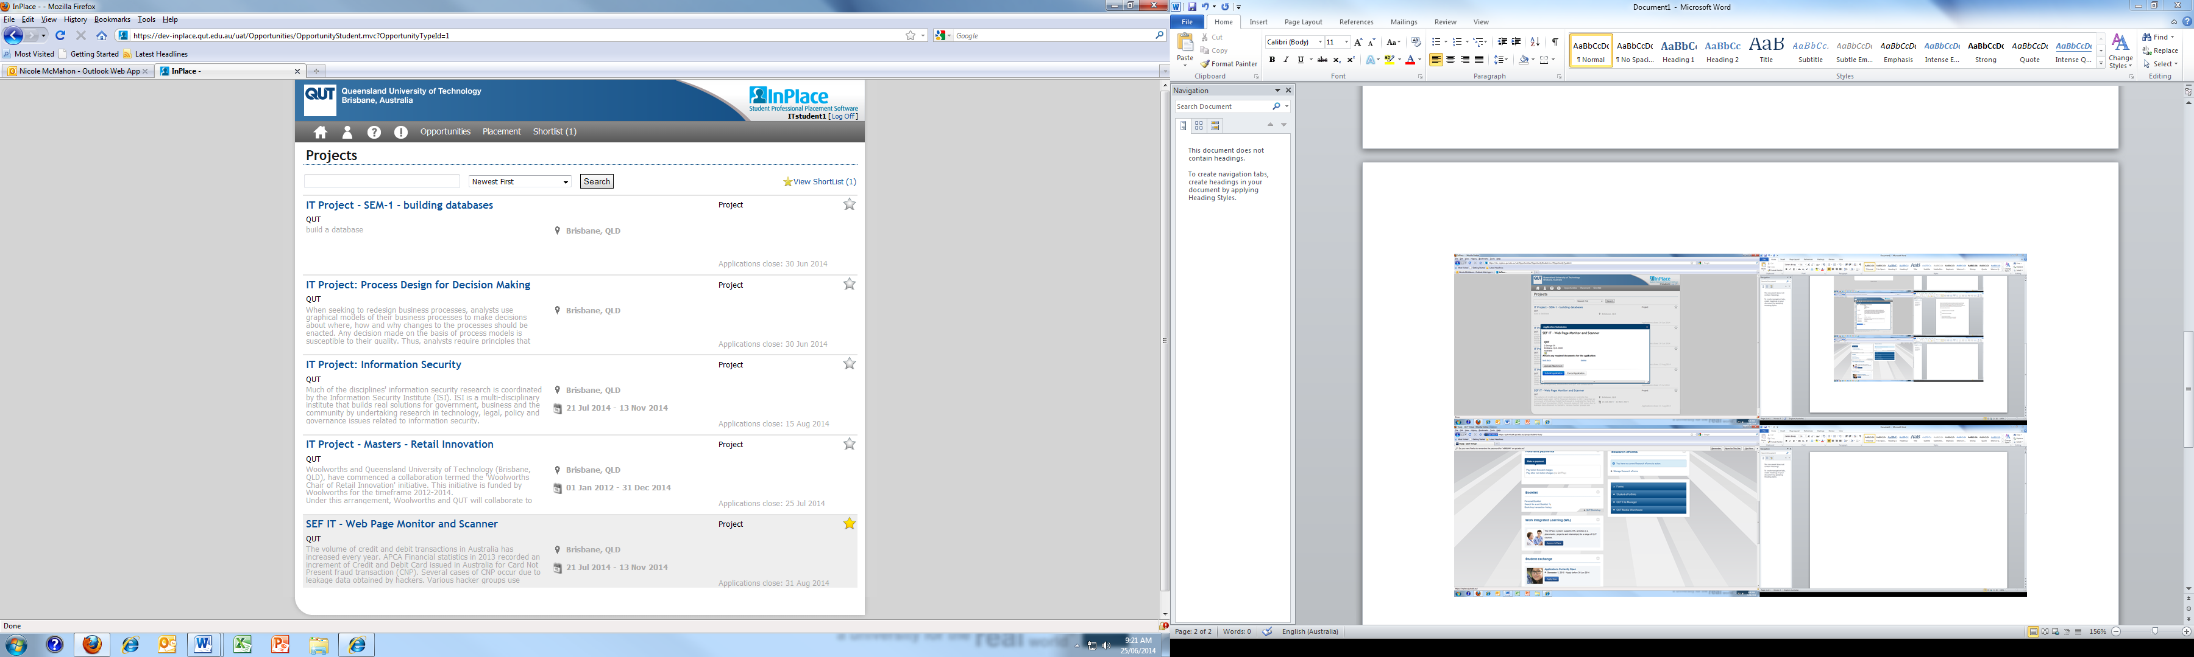
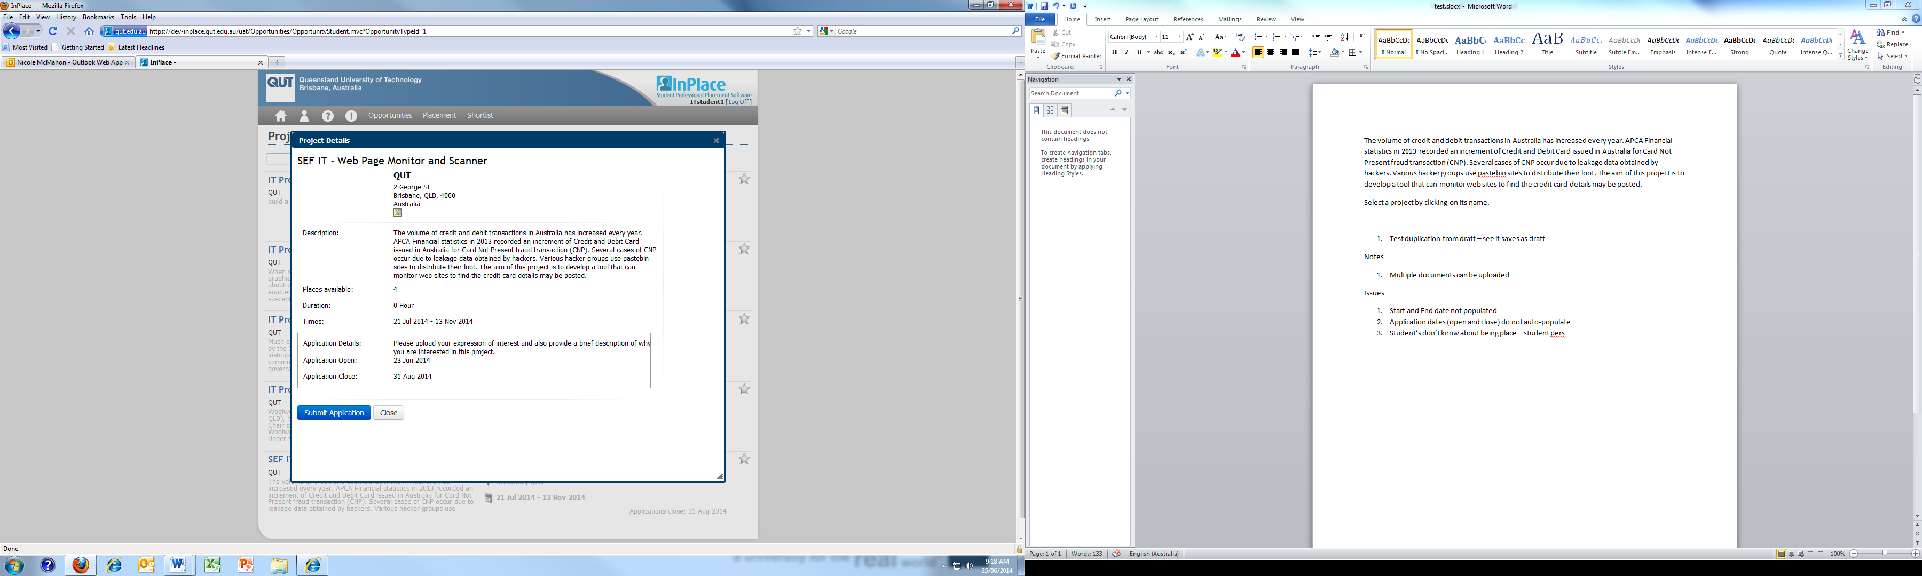
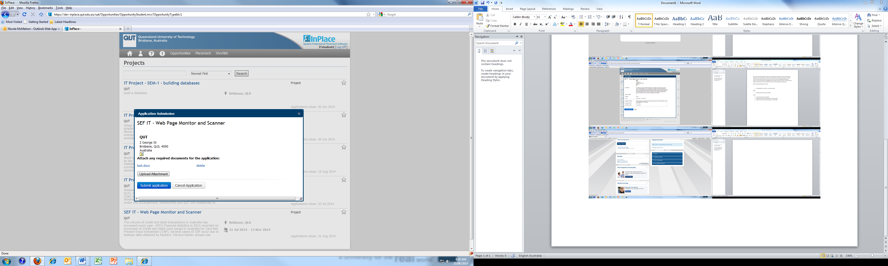
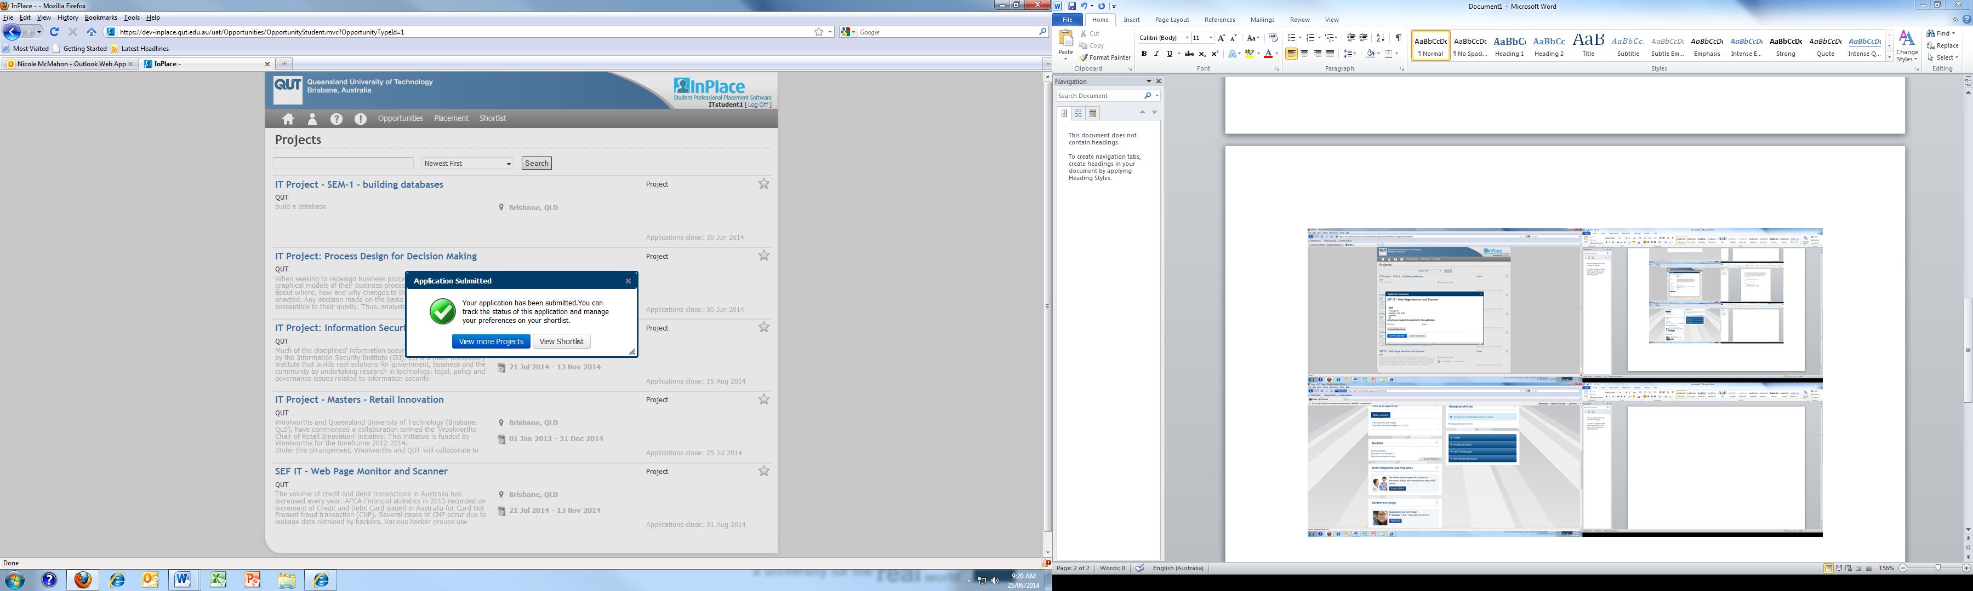
Finding a Project
Upload Application Document
Complete Application
Notes:
Iterate that this is an example and that the projects are actually named differently.
This slide works similar to the system. Animation guide steps below:
Click on the Projects List Image to make the application details screen appear
Click on the Projects to make the Application Submissions to appear – Click the Application Submission to make the two instruction bubbles appear
Click again on the Application Submission to make the Application Submitted appear, this is the last animation – clicking anywhere will change the slide.

Slide 17
Remember you should only apply for ONE project!
Notes:
Please ensure that the students know that they should only apply for one project at a time, if they are unsuccessful they should apply for another.

Slide 18
Application Outcomes
Once your application has been assessed, you will receive an email with the outcome.
If you have been successful:
Contact your project supervisor to begin your project.
Schedule regular project meetings with your project supervisor.
If you have been unsuccessful you may apply for another project.
Notes:
Feel free to add to this information

Slide 19
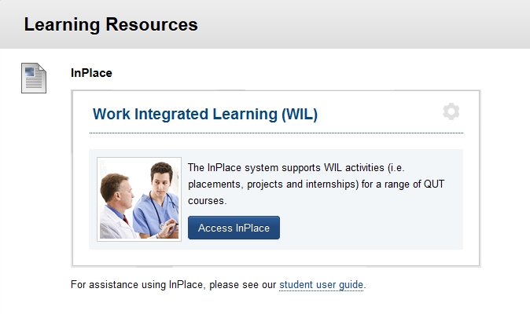
The User Guide
For assistance using InPlace, see the student user guide, under the Blackboard InPlace Link.
Notes:
User guide is up on Blackboard, under the

Slide 20
Question or Issues Regarding InPlace
Email: sef.wil@qut.edu.au
Remember to include:
Your full name
Student number
Course
Subjects should include ‘Project’.
Include these on all correspondence with us.
Check your QUT emails regularly.
Notes:
For any InPlace related questions or issues, students should contact sef.wil@qut.edu.au. Student emails should always include their full name, student number, their course and should include the word ‘Project’ in the email title. Including ‘Project’ in the subject will ensure that the email is directed to the correct administration staff member.

Slide 21
Project Administration
…and other questions

Slide 22
What is the Expected Workload
Each project is different, but expectations should be in line with credit points
12 credit point projects – 1.5 days or 12 hours per week
24 credit point projects – 3 days or 24 hours per week
48 credit point projects – 5 days or 48 hours per week
You can combine project units under one project topic just tell your supervisor for administration reasons

Slide 23
Projects are not in my Study Plan
Check to see if you have completed 48 credit points towards you degree
You may need to talk to your course coordinator to see if projects should be part of your major or electives
For new MIT degrees and IT44 all students must complete 48 credit points of project units
You might have to click on the Request Requisite Waiver link

Slide 24
There are No Project Supervisors
Project supervisors are mainly academic staff
Project supervisors can be PhD students
Projects must have at least one academic staff associated with it
Industry projects can have an industry supervisor as well
Students and Supervisors must meet regularly during semester

Slide 25
Group Projects
Group assignments are when the group submits one of each assessment item and share the same mark.
Group assignments will be strictly limited to 2 people max.
Multiple people can work on the same project topic but must submit different assessment items
Group assignments must include documentation describing work allocation of each participant

Slide 26
Marking and Moderation
With the new AQF requirements projects will be assessed differently.
Supervisors are discouraged from marking assignments
Moderators will be appointed for projects and will assess presentations and final reports
Unit Coordinator and sessional staff will mark project plans

Slide 27
What About Industry Based Projects
Industry projects may be completed at the industry workplace
There may be an industry supervisor as well as your academic supervisor
Assessment remains the same
Project plan will be assessed by supervisor
Presentations will be delivered to industry supervisor on site
Moderator should also be included in any NDA agreements

Slide 28
What about LIS and IM projects
LIS and IM projects are organised in a similar but different way
LIS and IM project have a different weighting on assessment
LIS and IM project require a separate Literature Review assessment item
See the LIS and IM community Blackboard site for any additional information

Slide 29
Consultation and Supervision
Ernest Foo (the unit coordinator) will be available for consultation on projects
Mondays 1pm – 4pm most weeks
If you are supervised by Ernest on a project he will meet you during this time
If you are unable to get a project see Ernest at this time

Slide 30

More Questions?

